Slide 1

Retail Business Analysis Dashboard

Slide 2
Project Overview
Retail business performance analysis
Focus on sales, pricing, discounts, and ratings
Data analyzed using SQL and Power BI
Goal: generate actionable business insights

Slide 3
Problem Statement
Retail businesses handle large volumes of product data, but identifying what truly drives sales and customer value remains challenging. High discounts do not always guarantee customer satisfaction or profitability. Some categories have many products but contribute less to revenue, while others generate high sales with fewer items. Without clear insights, pricing and inventory decisions may be inefficient. This project addresses these challenges by analyzing sales, discounts, ratings, and value metrics to support data-driven retail decisions.

Slide 4
Objectives
1
Analyze sales and product distribution by category
2
Evaluate discount and pricing effectiveness
3
Identify high-value and high-performing products
4
Compare customer ratings with pricing
5
Support insights using SQL validation

Slide 5



Data Preparation
Data Collection: Imported data from 139 csv files
Data Transformation: Concatenated multiple raw files into a single dataset, Cleaned missing values and inconsistent records, Standardized columns and data types in Python before
transferring the data to SQL.
Prepared for Analysis:
Created Calculated Column: value score
Measures: Total Sales, Total Products, Average Discount Rate, Average Customer Rating, Total Reviews

Slide 6




End-to-End Data Pipeline
Raw Files
Python
SQL
Power BI
Python: data cleaning & preparation
SQL: validation & business logic
Power BI: analysis & visualization

Slide 7
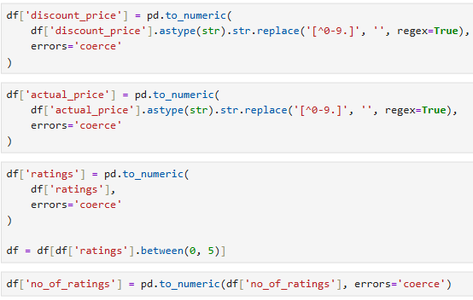
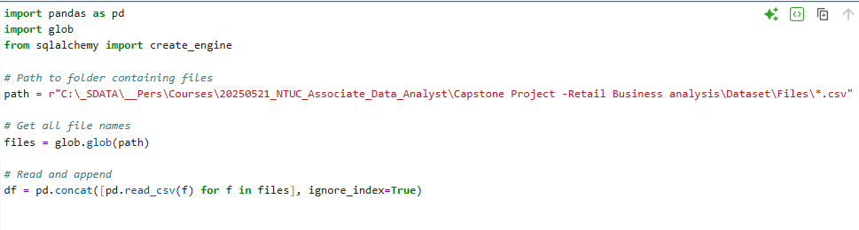
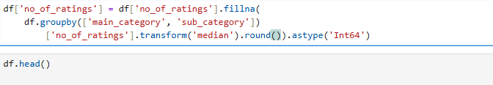
Python Data Cleaning – Sample Code
File concatenation
Null handling
Type conversion

Slide 8
Executive Summary
Total sales amount to 261.96M, showing strong revenue scale
The catalog contains 237K products, indicating wide assortment
Average customer rating is 3.81, reflecting generally positive feedback
Average discount rate is 55.19%, highlighting a discount-heavy pricing strategy
Value Score is relatively low (0.01) indicating discounts alone are not enough to create value, customer ratings and experience also play a key role.

Slide 9
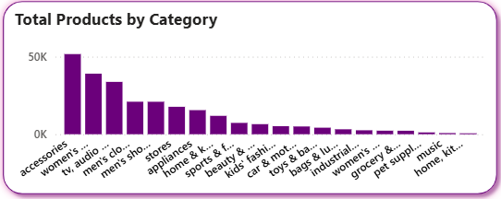
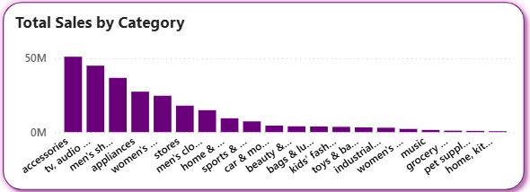
Category Performance
Products vs Sales
Accessories and women’s clothing dominate product count
Categories like TV & audio and appliances generate high sales with fewer products
Indicates uneven demand efficiency across categories

Slide 10
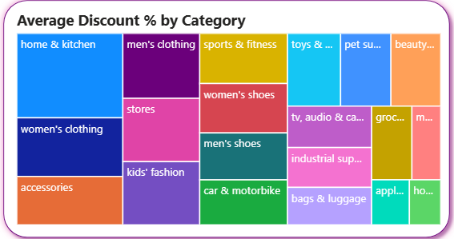
Discount Analysis
Discount Strategy by Category
Fashion, home & kitchen, and accessories receive the highest discounts
High discounts are often used in price-sensitive categories
However, heavy discounting may impact margins without guaranteeing higher value perception

Slide 11
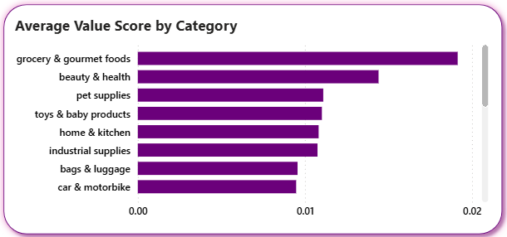
Value Score Analysis
Value Score by Category
Value score measures rating per price unit
Grocery & gourmet foods and beauty & health show higher value perception
Some categories with high discounts still deliver lower value scores
Best metric to identify value-for-money products

Slide 12
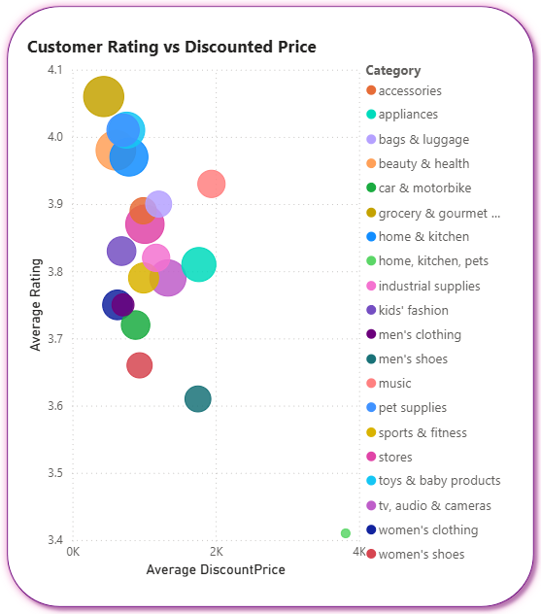
Rating vs Price Analysis
Rating vs Price
This scatter plot compares average discounted price and average rating
Most categories cluster between 3.7 and 4.0 ratings
Higher price does not guarantee higher ratings
Some low-priced categories maintain strong ratings
Indicates strong customer value perception

Slide 13
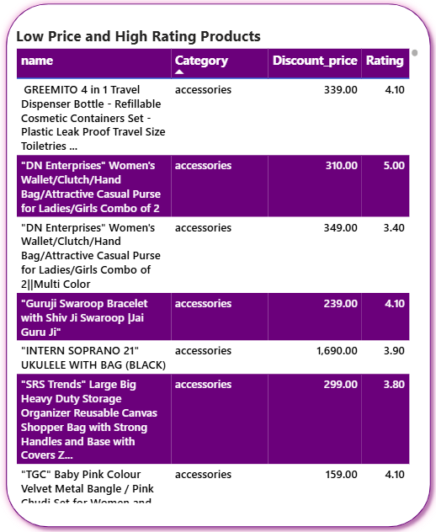
Low Price & High Rating Products
This table identifies products that are both affordable and highly rated
Accessories dominate this list
These are hidden value opportunities that can be promoted more aggressively

Slide 14
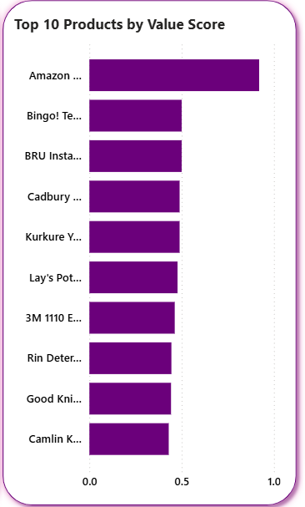
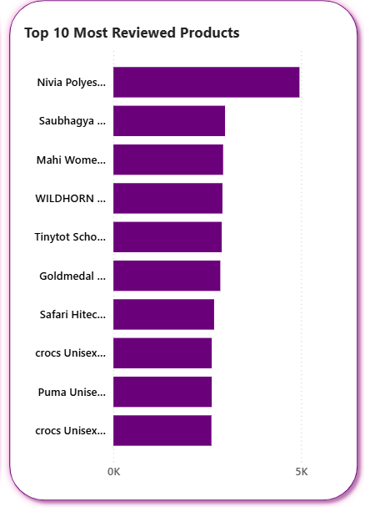
Products Insights
Top Value Products
Amazon eGift Card ranks #1 with a value score of 0.92
Top products offer the best balance of affordability and customer satisfaction
Top Reviewed Products
Highly reviewed products indicate strong demand and engagement
These products are ideal candidates for promotions, bundles, and recommendations
Helps prioritize best-selling products

Slide 15
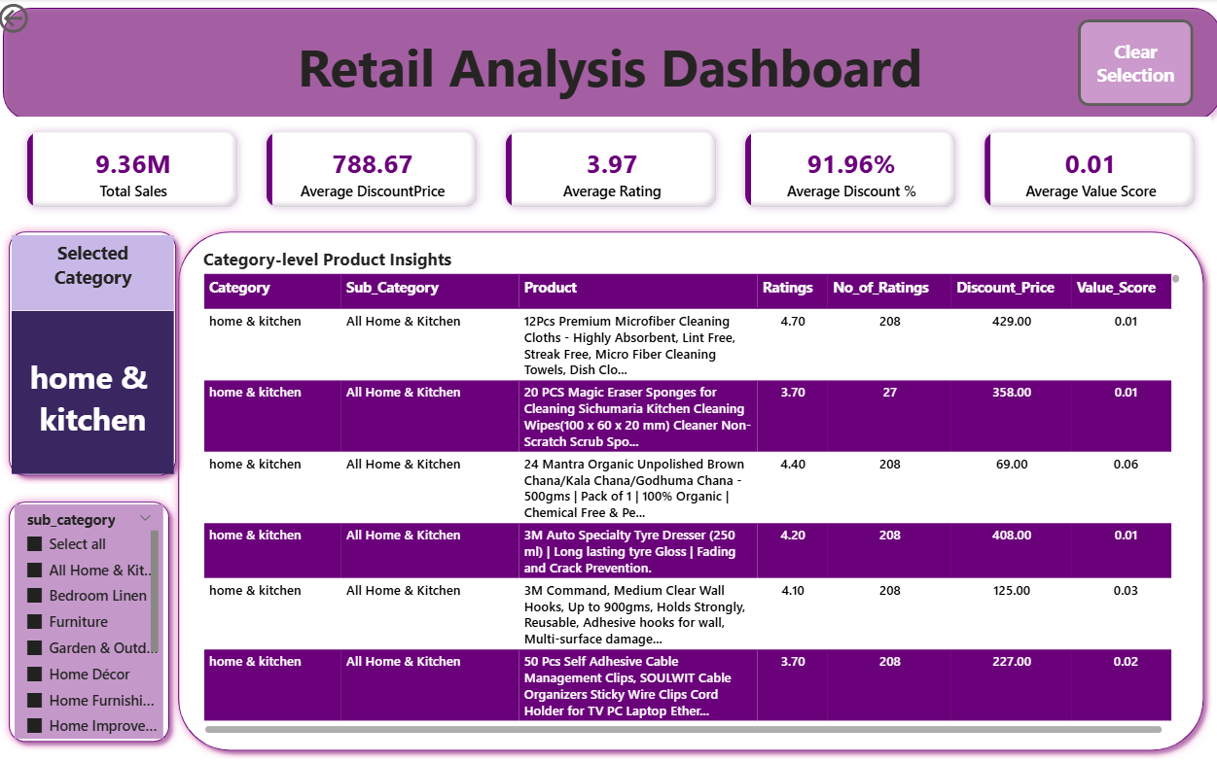
Drill-Through Analysis
SPOTLIGHT
Home & Kitchen
This is a drill-through page that allows deep analysis of a selected product.
Drill-through used for product-level insights
Shows category, subcategory, price, rating, value
Enables deeper analysis without clutter

Slide 16
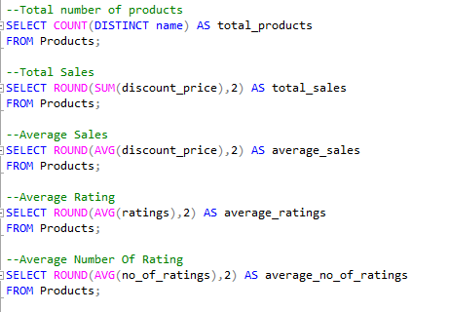
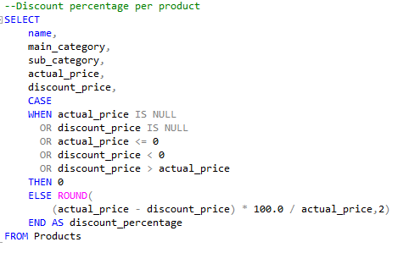
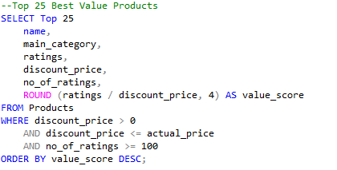
SQL Integration
SQL used for data validation and logic checks
Confirms KPIs, discounts, and value score
Ensures accuracy of Power BI insights

Slide 17
Conclusion
Sales driven by selected high-performing categories
Discounts alone do not define customer value
Value score reveals true value-for-money products
The project delivers actionable insights for retail decision-making

Slide 18
Recommendations
Focus on high-value, high-rating products
Promote high value-score products more prominently
Reduce excessive discounting in low-value categories
Use reviews to guide pricing and assortment

Slide 19

Thank You

